Slide 1
Delta Sigma Modulation in Fractional-N Phase Locked Loops
--Riley’s Paper
Student: Abhinav S
Advisor: Abhishek Srivastava
May, 2022

Slide 2
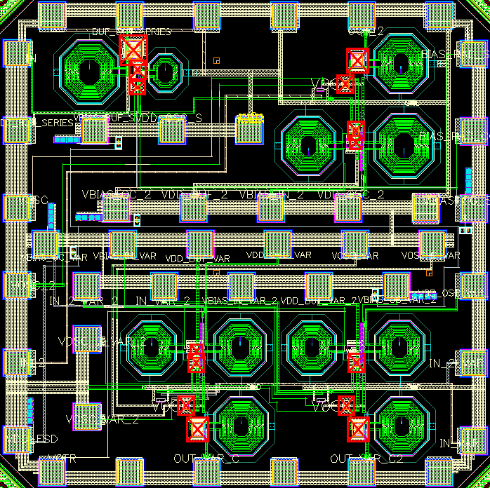
Project Summary
Project Title | IWR1843BOOST
PI | Dr. Abhishek Srivastava
Research lab | IC~WiBES Integrated Circuits inspired by Wireless and Biomedical Electronic Systems
Research center | Center for VLSI and Embedded System Technologies (CVEST)
Institute | International Institute of Information Technology Hyderabad

Slide 3
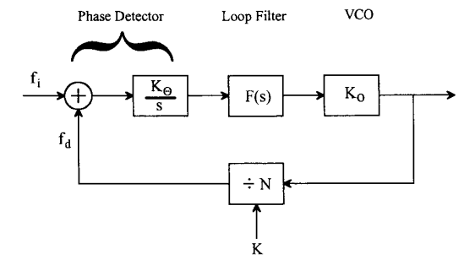
Phase Locked Loop
The PLL drives fd to be equal to fi.
So,Output frequency fo =Nfi
Output frequency is controlled by division ration N of Frequency Divider.

Slide 4
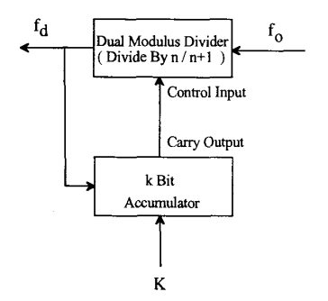

Pulse Swallowing
Divides by n when Carry output is 0 and by n+1 when Carry output is 1.
This achieves average division ratio n<N<n+1.
Problems:-
1.Output has significant low frequency component.
2.Output is periodic causing frequency spurs in the PLL output.

Slide 5
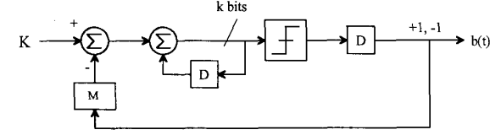
All Digital First Order Delta Sigma Modulator
In case of accumulator 0<K<2^{k.} In case of DSM, -M<K<M.
Additional delay in feedback.

Slide 6
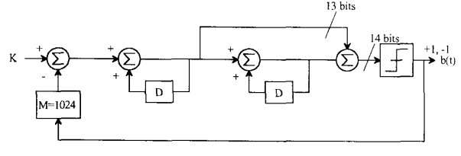
Higher Order Delta Sigma Modulator
First Order DSM does not remove frequency spurs completely as quantization error
is not randomized.
Higher order DSM reduces the periodicity of the output, removing frequency spurs.
For first order DSM,Noise shaping breaks for dc inputs but for higher orders,
it remains intact.
Phase detector mixed frequency at dc and fd to dc. Both of these are suppressed
by noise shaping of higher order DSM.These are the only components within loop
Bandwidth. Rest will be removed.

Slide 7
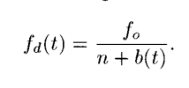
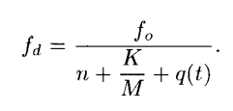
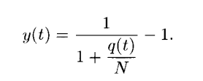





Analytical Expressions
-First Order
-Second Order Order

Slide 8
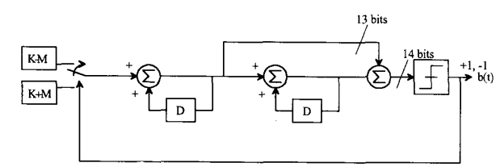

Experimental Results
Average Division Ratio:n+0.5+K/(2M)
Use of M allows control in channel spacing, which is fref/(2M).
Constraints:-
1.-0.5M<K<0.5M.
2.M<2k/2.5, k is width of accumulator.
These constraints come to provide stability of the output. If system is unstable,the
desired output won’t be realized.
Use of higher order DSM reduced quantization noise, but PSD of quantization noise
rises faster, 20dB per decade for second order, 40dB per decade for third order. etc.

Slide 9
Thanks

Slide 10
Backup Slides

